Slide 1
SOLAR ENERGY SYSTEMS FOR AGRICULTURE, BUSINESS, AND RESIDENTIAL

Slide 2
Who We Are/What We Do
Our business is part of a seven-store farm equipment enterprise that was started in 1987
We sold six Bergey 10Kw wind turbines from 2009 thru 2011
We now have a five year old solar brand as part of our product offering
with a Hoosier Heritage.
WE OFFER A UNIQUE SOLAR SYSTEM THAT USES SIMPLICITY AND CUTTING EDGE TECHNOLOGY AT THE SAME TIME TO PRODUCE MAXIMUM VALUE!

Slide 3
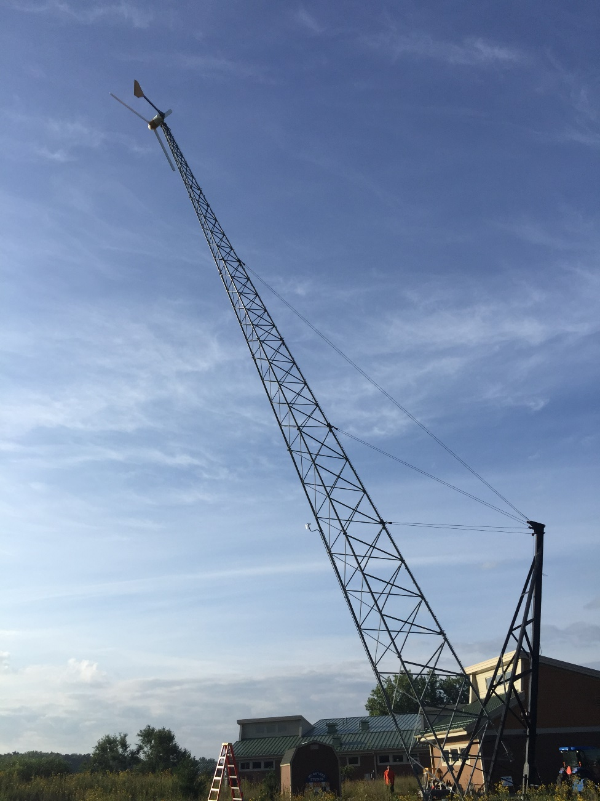
INNOVATION IS STANDARD EQUIPMENT
LOWERING A WIND TURBINE TOWER AT ANCILLA COLLEGE AUGUST 6, 2016 FOR THE FIVE-YEAR SERVICE. THE AUXILIARY TOWER SAVES HIRING A CRANE, GREATLY REDUCES COSTS AND IS MUCH SIMPLER.

Slide 4
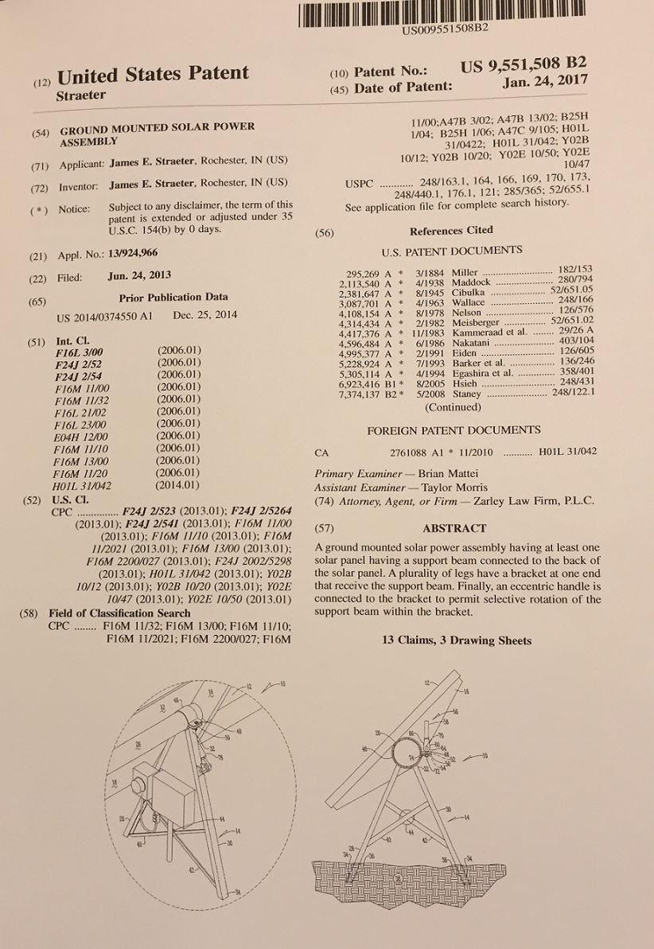
Thinking Differently is NORMAL
SOLARCAM
Patent issued
January 24, 2017
Provides for
Single Axis Tracking
In the Southern
Sky with no
moving parts.

Slide 5
SOLAR REDUCES COSTS!
DURING ITS 30-YEAR EXPECTED LIFE, SOLAR ENERGY INSTALLED TODAY WILL PRODUCE ENERGY AT THE RATE OF 2.7 CENTS/KWH!

Slide 6
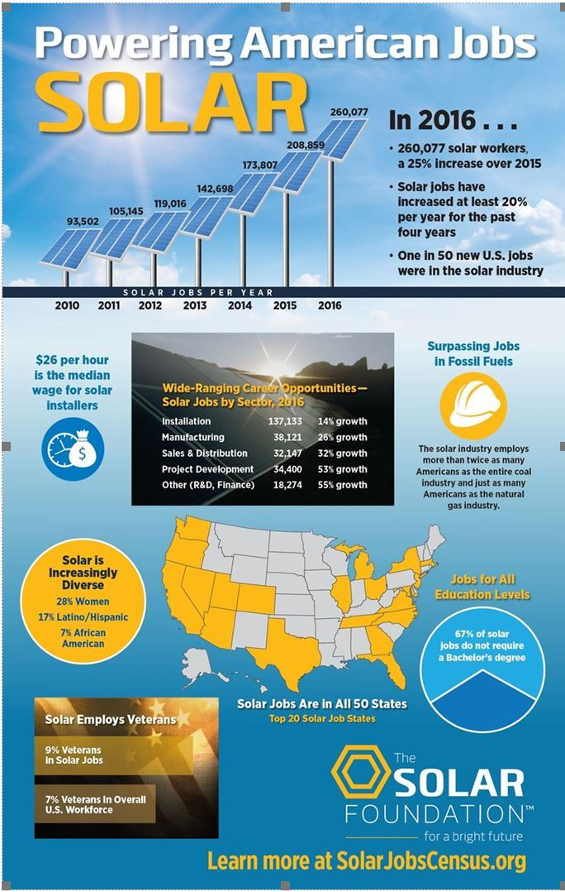
There Is Lots Happening There are more people working in solar than in oil, gas and coal combined!

Slide 7
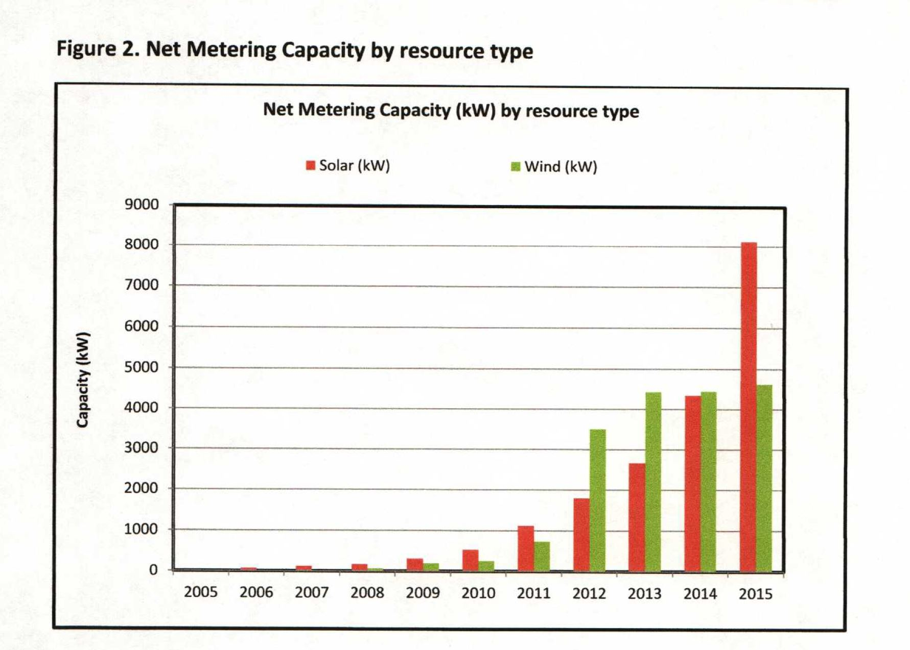
WIND IS GETTING BLOWN AWAY

Slide 8
ENERGY COSTS ARE RISING, RIGHT?

Slide 9
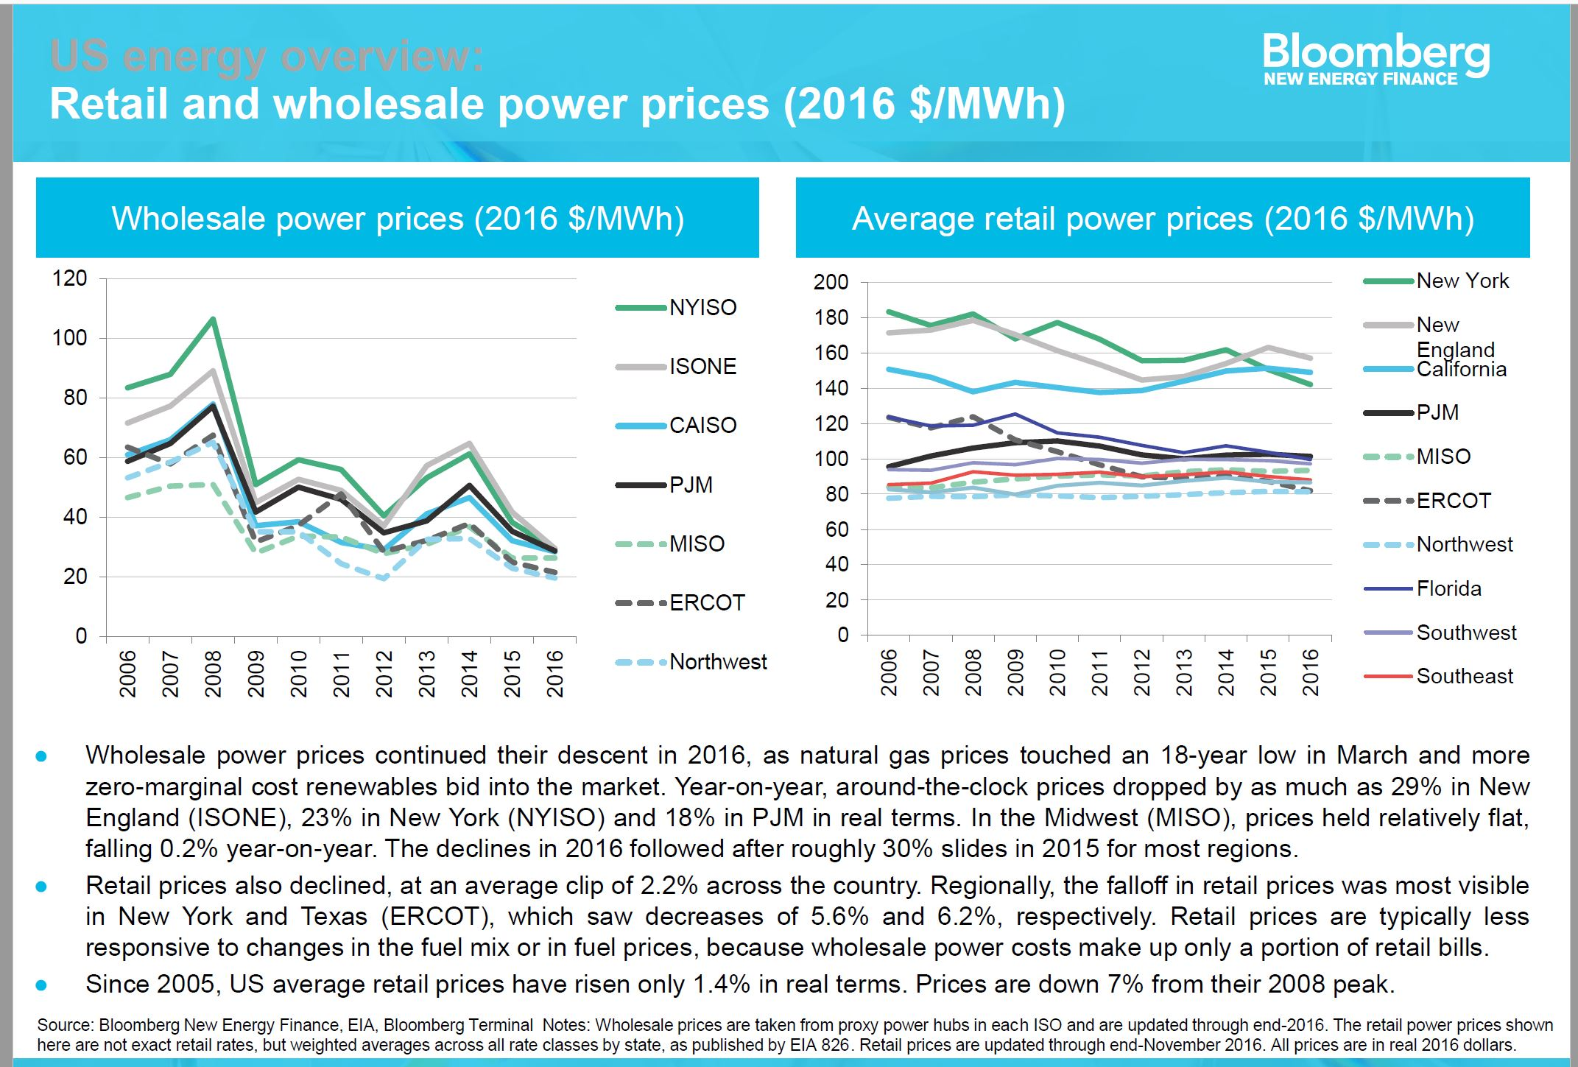
ONLY THE CUSTOMER’S PRICE IS

Slide 10
SOLAR HAS AN INERENT TIME OF DAY BENEFIT COMPARED TO WIND

Slide 11
Understanding Solar Is More Than Panels and Inverters
TED VIDEO

Slide 12
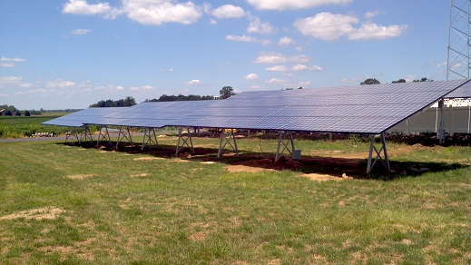
Array Configuration Makes Us Different
Simple design with panels mounted on a single horizontal pipe that is
supported by legs

Slide 13
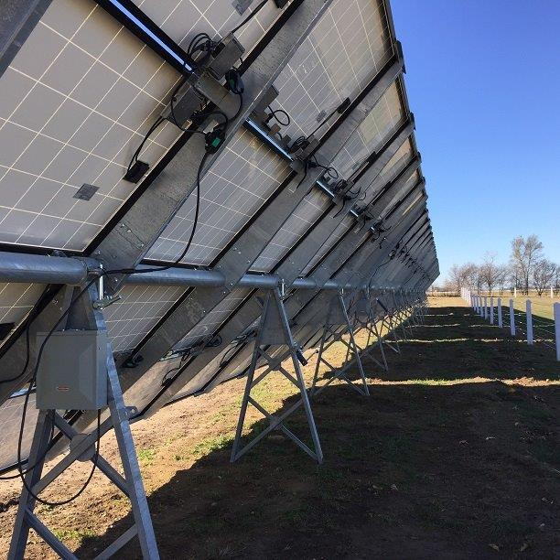
Panels are bolted to outriggers which are fastened directly to welded plate on the horizontal pipe.

Slide 14
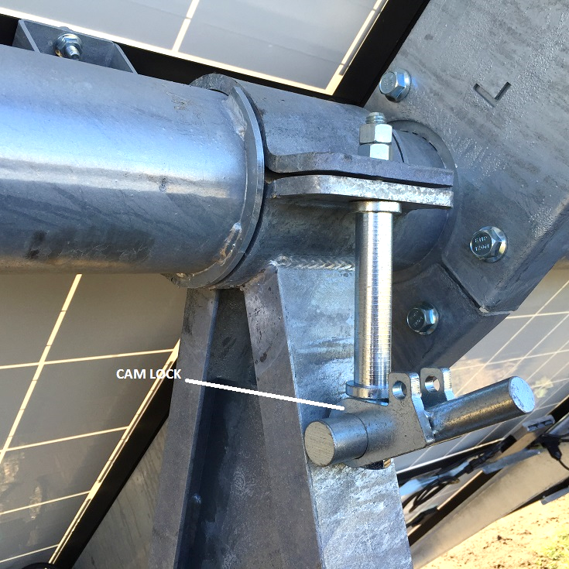
Patented Cam Lock Simplifies Adjustment

Slide 15
Simple Mechanical Jack Does The Adjusting of the Array
Adjustment Demo Video

Slide 16
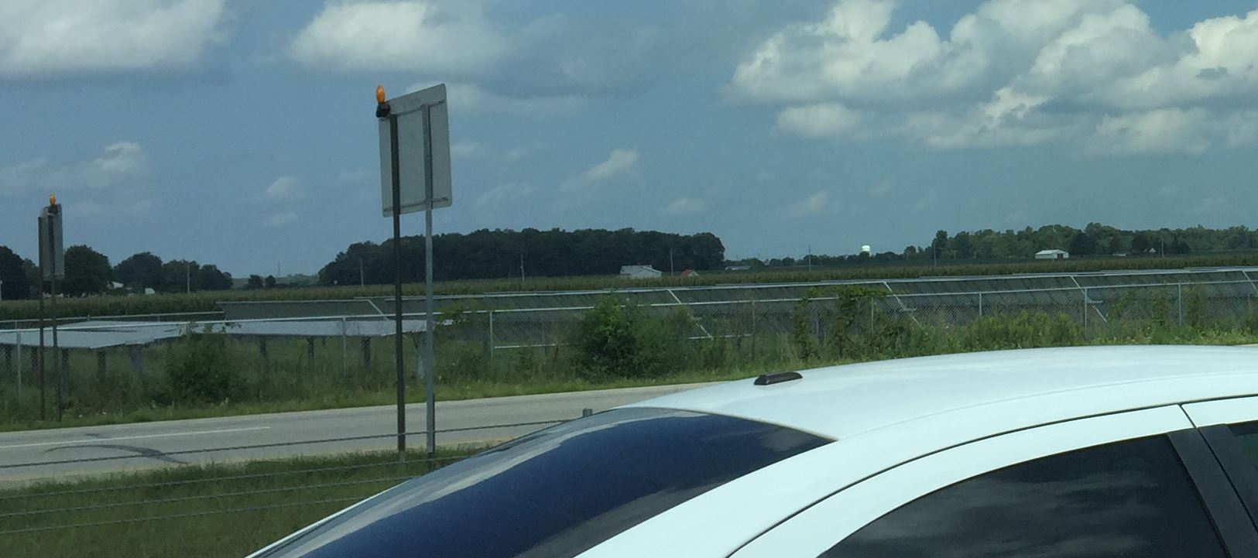
This is why SIMPLE is better than AUTO

Slide 17
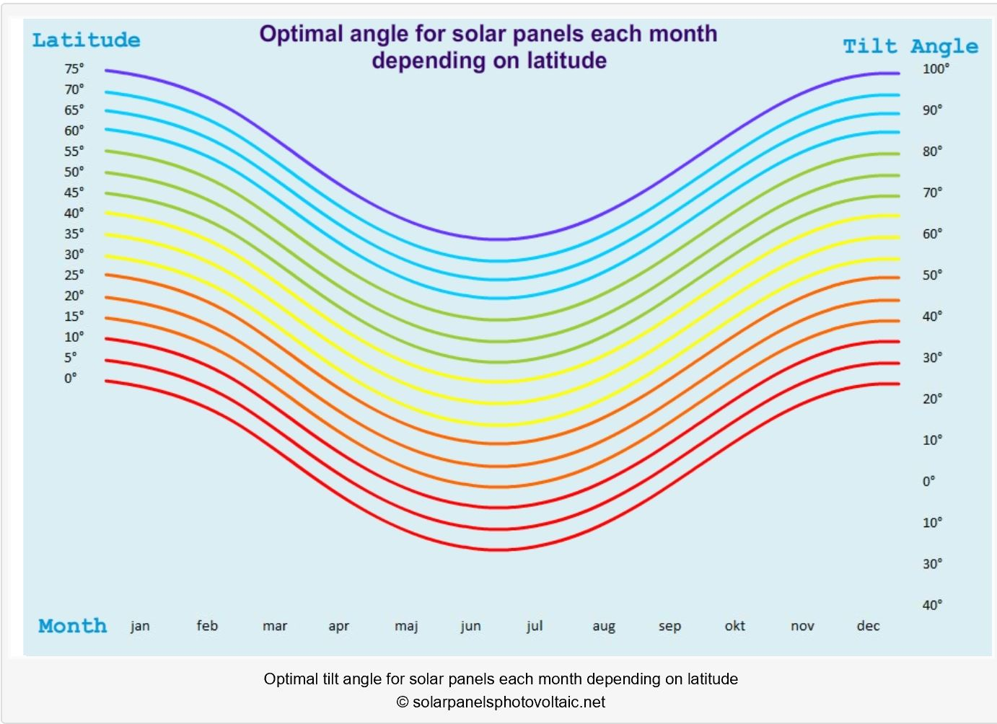
IS ANGLE IMPORTANT?
WITHOUT SOLAR TILT WE WOULDN’T HAVE SEASONS

Slide 18
ANGLE MATTERS AND RARELY IS THE IMPACT VISIBLE
SHOW LIGHT IMPACT VIDEO

Slide 19
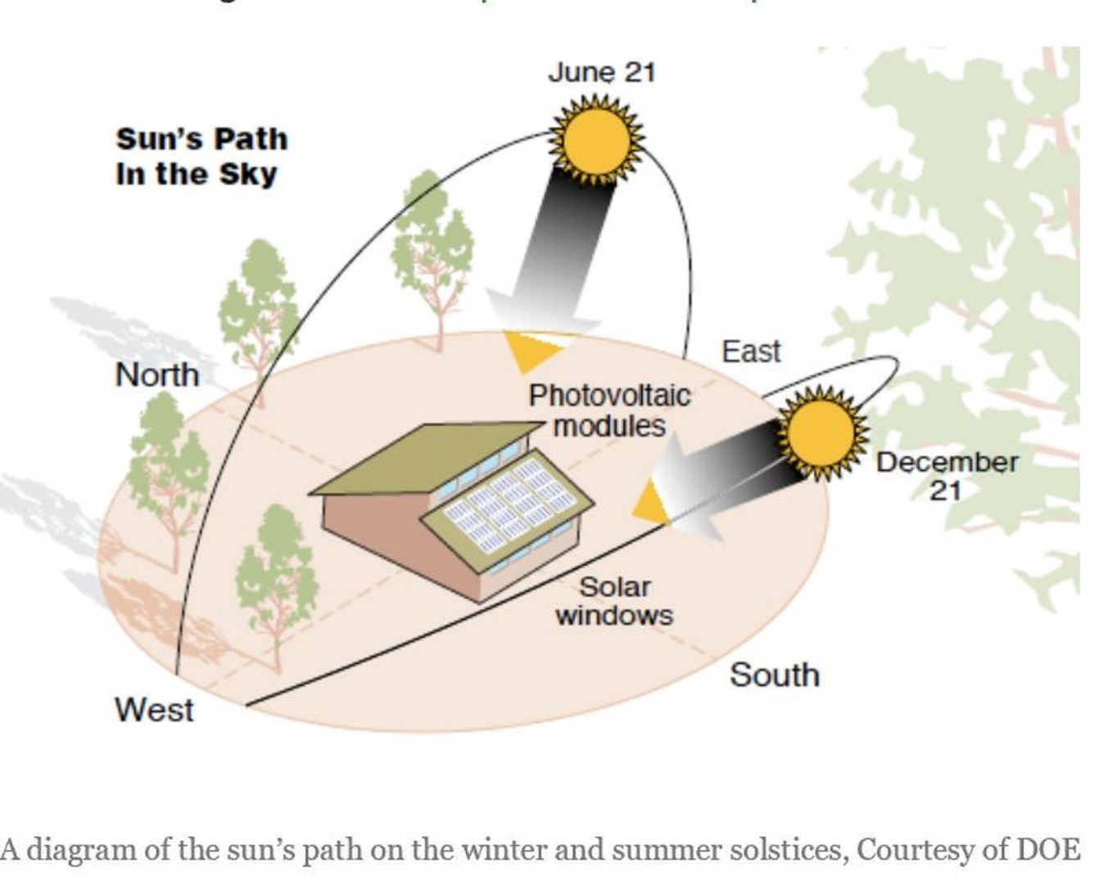
The Sun’s Path Means Perfect Angle Rarely Happens. The Best One Can Do Is to Get the Best Average Angle

Slide 20
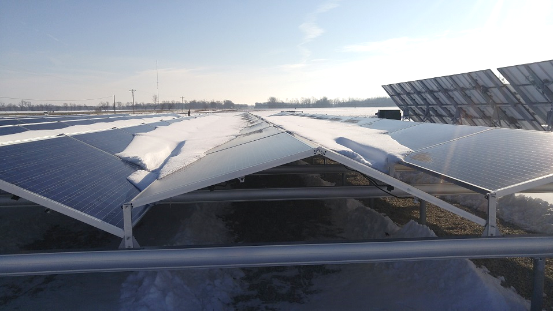
TILT VS NON-TILT, THERE ARE OTHER BENEFITS.

Slide 21
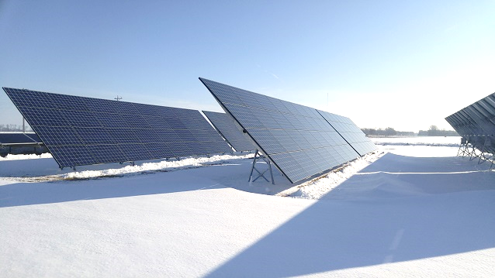
ADJACENT SOLARCAM SYSTEM

Slide 22
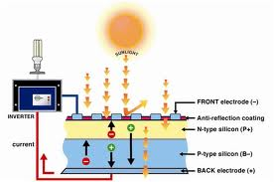
How Does Solar Work?
Solar is Simple With No Moving Parts

Slide 23
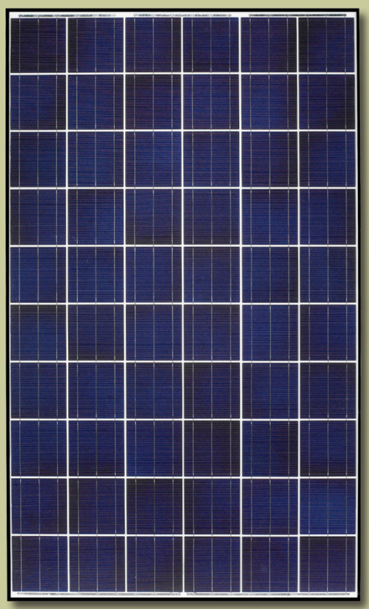
Solarworld Panels offer legacy performance, solid company support and competitive pricing!
Buying an unproven or low-cost
Panel is a common mistake
25-year warranty, 30 + year expected life

Slide 24
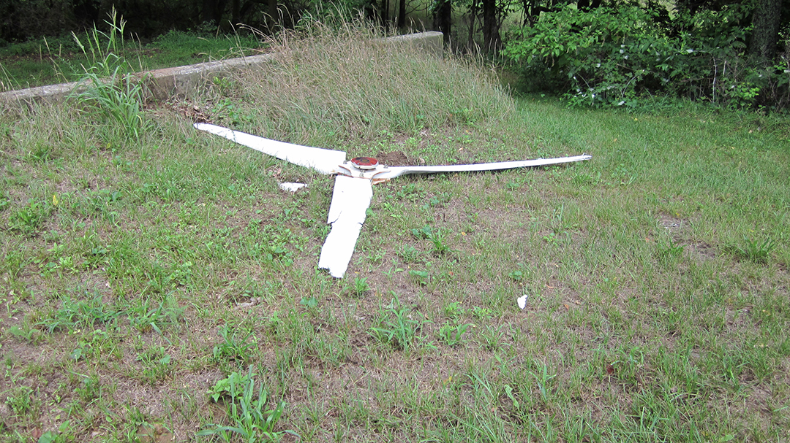
THIS IS WHAT LOW COST LOOKS LIKE
SOMETIMES LOW COST ISN’T LOW PRICE

Slide 25
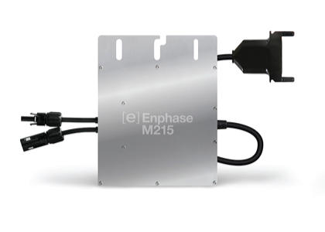
Enphase Microinverters Only Option Other Than String Inverter
Provides per-panel performance data
And Lifetime of Value

Slide 26
Frost, Snow, and Reporting are big issues that micro-inverters help fix.

Slide 27
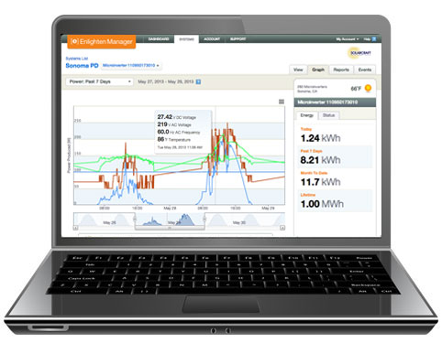
Check Performance and History via Internet!
AFTER INSTALLATION YOU HAVE TO MAINTAIN THE SYSTEM
MICROINVERTERS DO THAT BETTER THAN ANY OTHER!

Slide 28
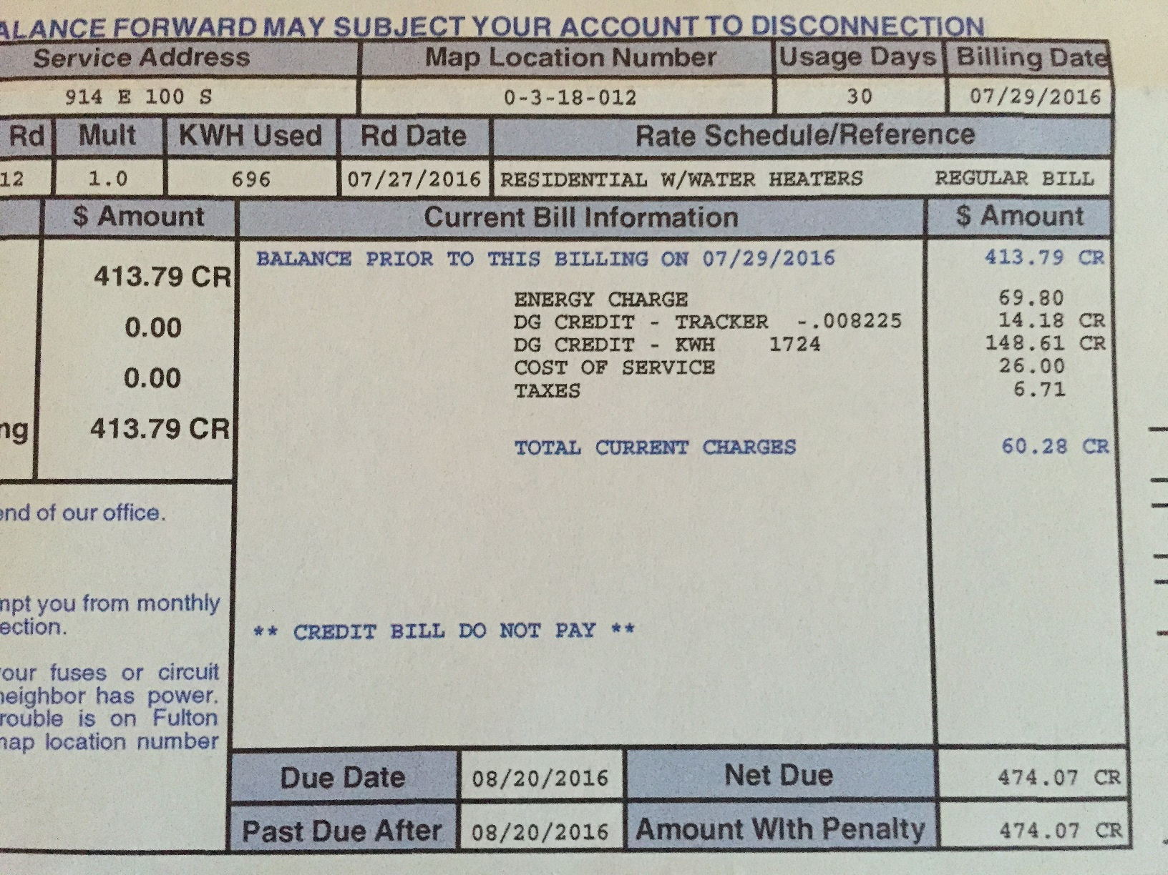
This is what your electric bill should look like!
Our home is totally electric!

Slide 29
Purdue Study on Economics of Solar using data from our system verifies competitive costs compared to grid. Go to www.agtechnologiesinc.com for the entire report or ask and we’ll send a paper copy.

Slide 30
Solar is Safe and Durable
SAFETY IS ALWAYS IMPORTANT
MICROINVERTER SYSTEM HAS MAXIMUM 60V DC WHEREAS OTHER INVERTER SYSTEMS HAVE 1000V DC
HIGH VOLTAGE IS VERY DANGEROUS
HIGH VOLTAGE CONTRIBUTES TO PANEL DECAY
Enphase Micro Inverters meet NEC code adopted Jan. 1, 2017 for rapid shutdown.

Slide 31
SOLARCAM PROVIDES PEAK EFFICIENCY
 |  |  | Production YTD to 11/3/2016
Owner | System Brand | DC Rating (Kw) | YTD 2016 (Kwh) | Kwh/Kw | % to K V REMC
Kankakee Valley | Solarcam | 57.1 | 74359 | 1302.26 | 100%
Phil Overdorph | Solarcam | 65.2 | 81232 | 1245.89 | 96%
Dave Smith | Solarcam | 29.45 | 37912 | 1287.35 | 99%
Crawfordsville | IMPA | 3660 | 3944734 | 1077.80 | 83%
Frankton | IMPA | 1200 | 1181889 | 984.91 | 76%
Peru | IMPA | 3660 | 3727318 | 1018.39 | 78%
New Castle | Hoosier Energy | 1339.2 | 1620812 | 1210.28 | 93%
Mill Creek Elementary | Johnson Melloh | 330 | 339000 | 1027.27 | 79%

Slide 32
WE PROVIDE ONE PRICE FOR EVERYTHING. MOST VENDORS DON’T
WE DO INSTALLATION OF SOLAR PANELS WITH A DEDICATED CREW
WE’LL PROVIDE ELECTRICAL HOOKUP OR WORK WITH YOUR ELECTRICIAN
WE DO THE SIGN UP FOR YOU TO SELL CARBON CREDITS AND THEN TURN IT
OVER TO THE CUSTOMER
WE’LL DO THE PAPERWORK FOR THE UTILITY INTERCONNECTION
WE’LL SET UP THE SOLAR SYSTEM ON YOUR INTERNET SERVICE AT THE SITE SO YOU
MONITOR THE PERFORMANCE EASILY
WE ASSIST THE CUSTOMER’S USDA GRANT APPLICATION PROCESS

Slide 33
A FEW IMPORTANT MATTERS WE ARE WORKING ON!
SENATE BILL 309
HOUSE BILL 1624

Slide 34
WHAT ABOUT PAYBACK?????

Slide 35
WHAT ABOUT PAYBACK?

Slide 36
Questions?

Slide 37
THE ONLY ONE YOU NEED TO ANSWER IS:
WILL YOU STILL
BE DOING THE SAME THING ABOUT YOUR ENERGY
NEEDS A YEAR FROM NOW OR WILL YOU HAVE
TAKEN STEPS TO CONTROL YOUR COSTS FOR THE
NEXT 30 YEARS?

